Slide 1
Mini Project Progress Review #2
Project Title: Energy efficiency for HDFS
Project ID: MPW20HLP03
Project Guide: Prof. H L Phalachandra
Project Team: Abhishek Das (PES1201800177) N Sanketh Reddy (PES1201800389) Bhargav SNV (PES1201800308)

Slide 2
Project Abstract and Scope
Abstract:
With growth of big data, the need for distributed computing and clusters is higher than ever.
By using distributed computing, tasks can be split and processed in parallel. But the energy consumed by clusters to compute is high.
Almost 55% of resources aren’t used in clusters. They remain in their idle state, wasting a lot of energy.
Our project aims to conserve energy in these clusters.

Slide 3
Project Abstract and Scope
Scope:
The scope of this project is to reduce energy consumption in HDFS. We will simulate various conditions to devise effective means of energy conservation.
This project will not involve working on the Hadoop codebase.
Project will use simulation software to test HDFS power consumptions and further analysis will be done on the same.

Slide 4
Further Literature Survey
Relevant Research Papers:
Dynamic Energy Efficient Data Placement and Cluster Reconfiguration Algorithm for MapReduce Framework. N. Maheshwari, R. Nanduri, V. Varma This paper discusses energy efficient data placement and cluster reconfiguration(balancing) which dynamically scales clusters in accordance to the workload imposed on it.
Shortcomings: This methodology requires frequent dynamic reconfiguration of the cluster. This is a resource heavy operation.
GreenHDFS: Towards An Energy-Conserving, Storage-Efficient, Hybrid Hadoop Compute Cluster. R. T. Kaushik, M. Bhandarkar This paper describes the concept of using "Hot and Cold zones", where Hot Zones have high computational hardware and contain data that is frequently used. Cold Zones have larger disks and energy conserving hardware which store large amounts of data that are not frequently used.
Shortcomings: There is no dynamic policy to shift data among Zones. Scaling zones is also an issue.

Slide 5
Further Literature Survey
Relevant Research Papers:
Hybrid HDFS: Decreasing Energy Consumption and Speeding up Hadoop using SSDs. I. Polato, F. Kon, D. Barbosa and A. Hindle This paper describes the use of different types of disks to improve energy and compute efficiency. The file system is split into two storage zones, one using SSD and the other with HD. A predefined policy determines which zone a block is stored in.
Shortcomings: This requires a lot of manual configuration and policies for storage must be updated frequently. These processes are not dynamic.
Scheduling and Energy Efficiency Improvement Techniques for Hadoop Map-reduce. N. Tiwari This paper discusses various scheduling algorithms to save energy for MapReduce tasks. A few algorithms discussed are Delay algorithm, Constraint scheduling algorithm, schedulability test algorithm.
Shortcomings: All algorithms discussed work on Map Reduce layer (Application) of Hadoop, it does not help with energy conservation at the HDFS (Storage) layer.

Slide 6
User Characteristics
Companies running large scale Hadoop clusters would find it beneficial to adapt our model.
Several types of data streaming into a large amount of servers.
Server running/maintenance power costs substantial
Big Data servers have constant middle to high resource utilization

Slide 7
Dependencies / Assumptions / Risks
Legal Implications:
All software, tools and frameworks used are open source and have no legal implications
Software Dependencies:
Java environment with IDE.
HDFS-Sim setup.
Hardware Dependencies:
Systems used have a minimum of Intel i5 cores with 8 GB ram and sufficient storage space.

Slide 8
Dependencies / Assumptions / Risks
Risks
Algorithms works only in theory but not in real-world scenarios.
Failure of integration of algorithm with Hadoop code base.
Simulator cannot measure energy consumption for our setup.

Slide 9
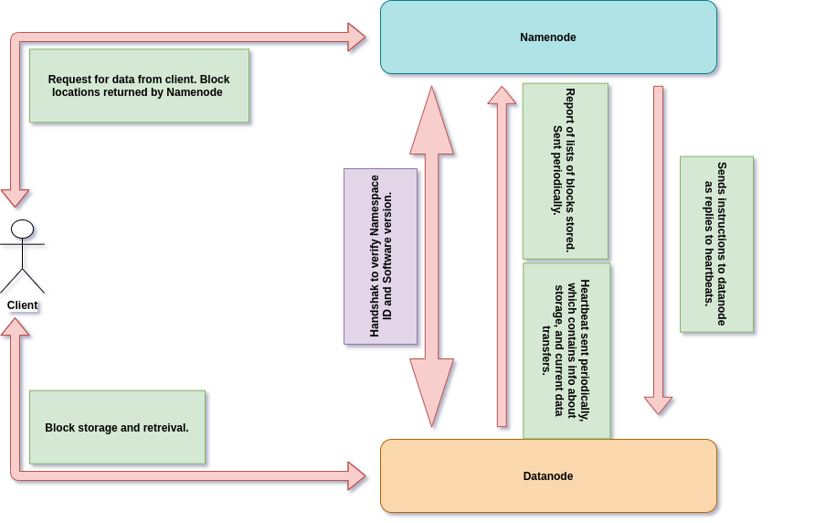
Hadoop Architecture
Notes:
<number>

Slide 10
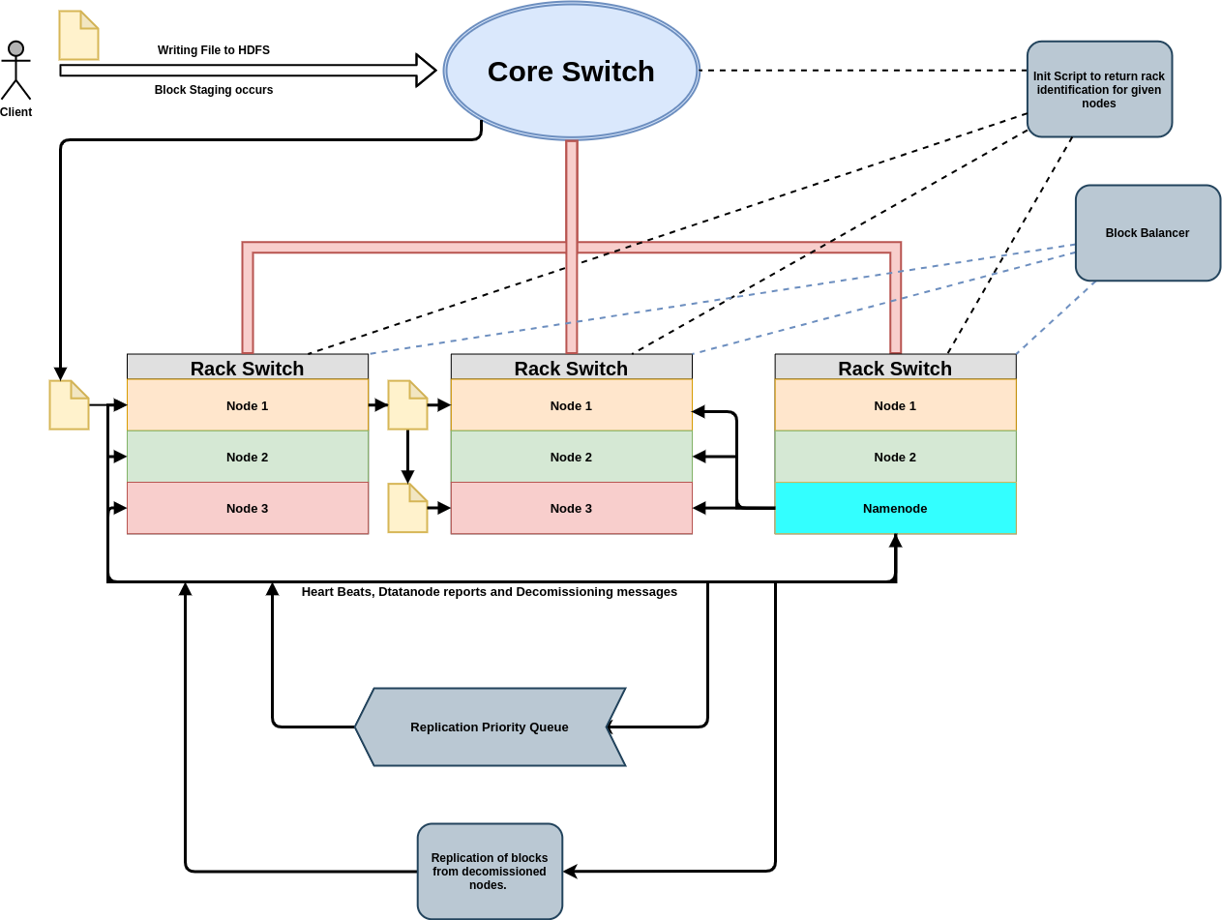
Hadoop Architecture
Notes:
<number>

Slide 11
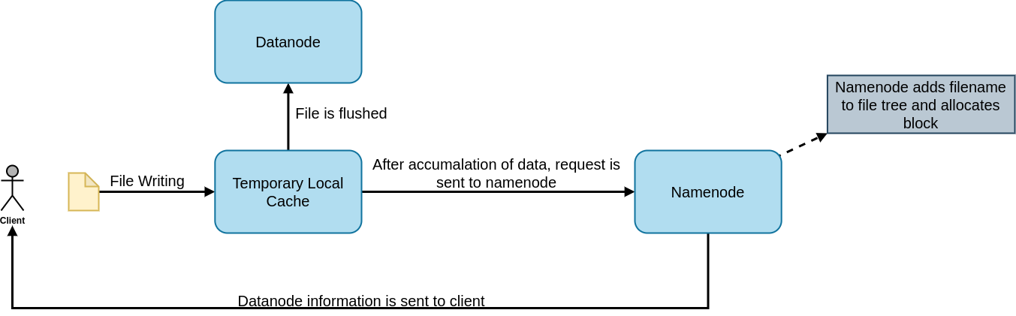
Hadoop Architecture (Staging)
Notes:
<number>

Slide 12
Modules
HDFS replication simulator: To evaluate effect of deployment platform and workload characteristics on data availability.
A new block placement policy and heartbeat mechanism.
Dynamic data storage/transfer mechanism between hot and cold zones.
Notes:
<number>

Slide 13
Actual Hadoop Architecture
Notes:
<number>

Slide 14
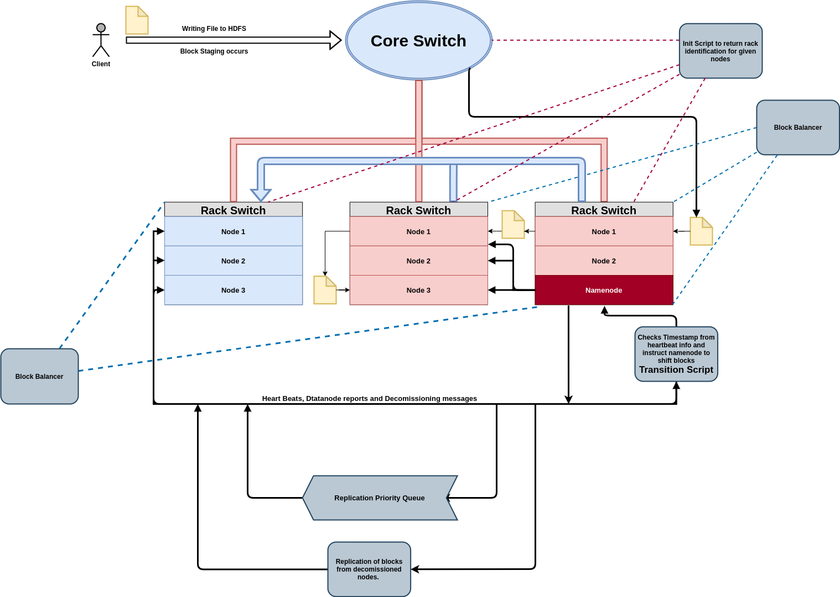
Policy and Algorithm 1 of 2 (Infrequent Transfer)
Notes:
<number>

Slide 15
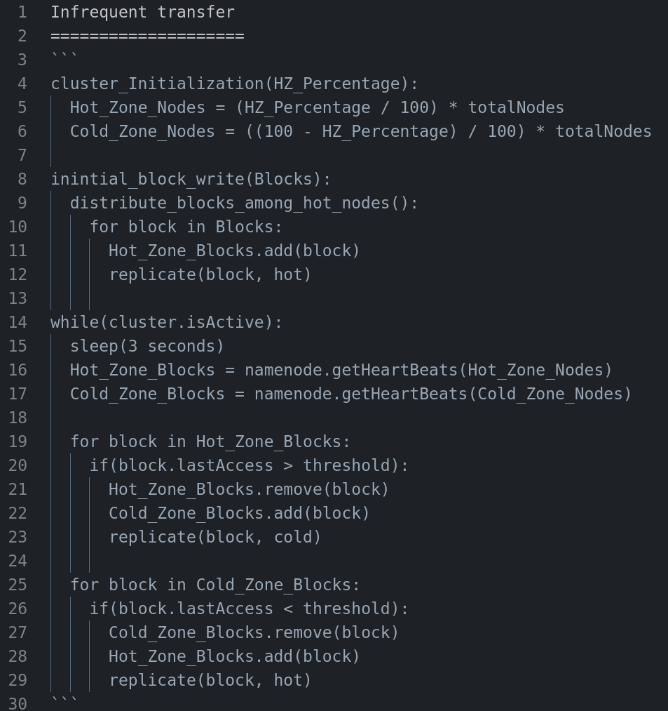
Policy and Algorithm 1 of 2 (Infrequent Transfer)
Notes:
<number>

Slide 16
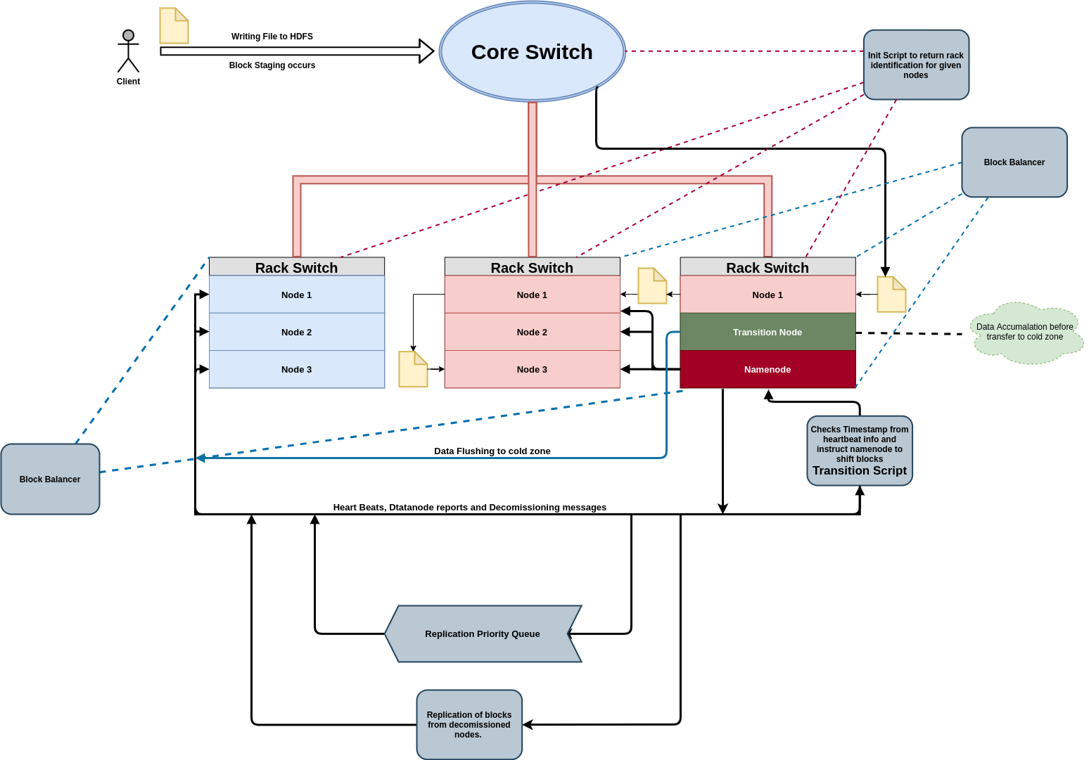
Policy and Algorithm 2 of 2 (Frequent Transfer)
Notes:
<number>

Slide 17

Policy and Algorithm 2 of 2 (Frequent Transfer)
Notes:
<number>

Slide 18
Technologies Used
HDFS replication simulator
Java
Draw.io
Notes:
<number>

Slide 19
Thank You

